Slide 1
ESPEAK

Slide 2
$ sudo apt-get install espeak
Sudo raspi-config
From terminal:
$ sudo espeak -p 100 –s 50 –v m1 –f file.txt

Slide 3
Modifying speech
Attributes:
-v f1 (or) –v m1 for different voices
-p200 for changing pitch
-s50 for speed
-f filename for calling a file content to espeak

Slide 4
FILE I/O operations
Writing to a File:
>>> f = open('test.txt', 'w')
>>> f.write('This file is not empty')
>>> f.close()

Slide 5
Reading from a File:
>>>f = open('test.txt')
>>>s = f.read()
>>>f.close()
>>>print(s)

Slide 6
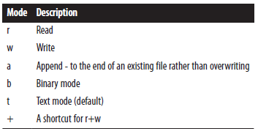
File modes

Slide 7
Importing modules
There is a very large number of modules (sometimes called libraries) available for Python.
Many are included with Python as standard and others can be downloaded and installed into Python.

Slide 8
Use the import command:
1)>>>import random
(or)
2)>>>from random import *
(or)
3)>>> from random import randint

Slide 9
Ex1
>>> import random
>>> print(random.randint(1,6))
2
>>>

Slide 10
Ex2
>>>from random import *
>>> print(randint(1,6))
4
>>>

Slide 11
Ex3
>>> from random import randint
>>> print(randint(1,6))
2
>>>

Slide 12
simply
>>> import random as R
>>> R.randint(1, 6)
3
>>> import random as R
>>> R.choice(['a', 'b', 'c'])
'a'
>>> R.choice(['a', 'b', 'c'])
'b'
>>> R.choice(['a', 'b', 'c'])
'a'

Slide 13
Handling Exceptions
try:
f = open('test.txt')
s = f.read()
f.close()
except IOError:
print("Cannot open the file")

Slide 14
list = [1, 2, 3]
try:
list[8]
except:
print("out of range")
else:
print("in range")

Slide 15
Finally putting all together
espeak.py.txt

